Slide 1
Setting up an MPLS network in the Lab
by
Group 1
Rahul Mittal(07305003)
SeshuRaju P(07305028)
Election Reddy B(07305054)

Slide 2
Outline
Introduction
Commands
Experiments
References

Slide 3
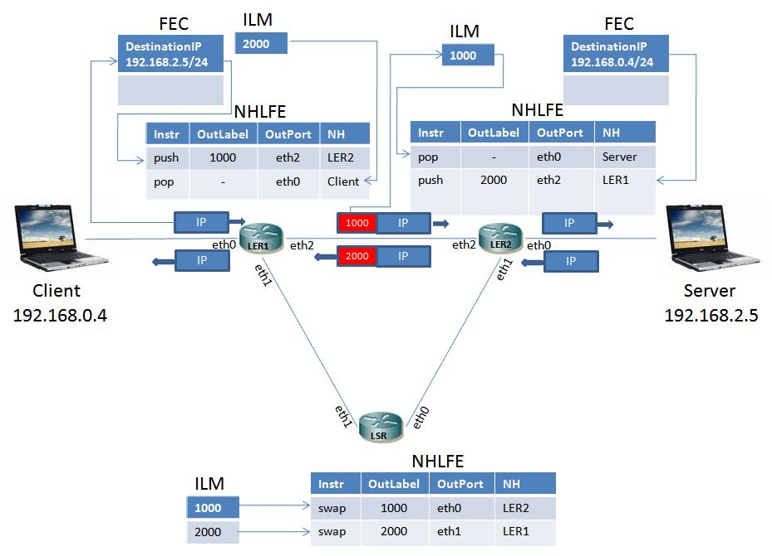
Introduction

Slide 4
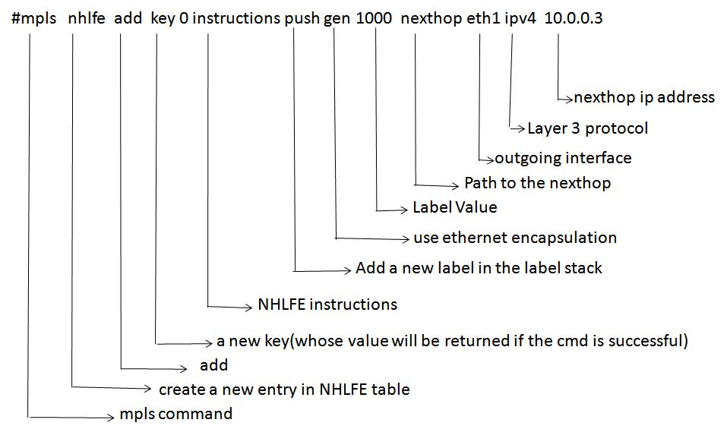
Commands

Slide 5
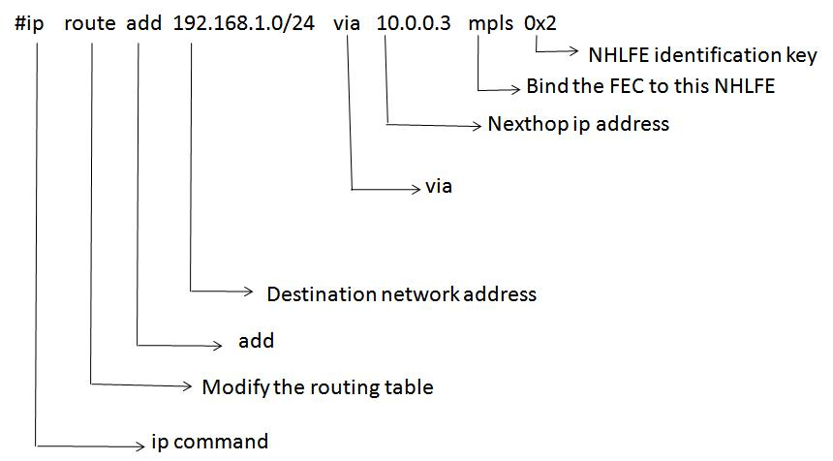
Commands(contd…)

Slide 6
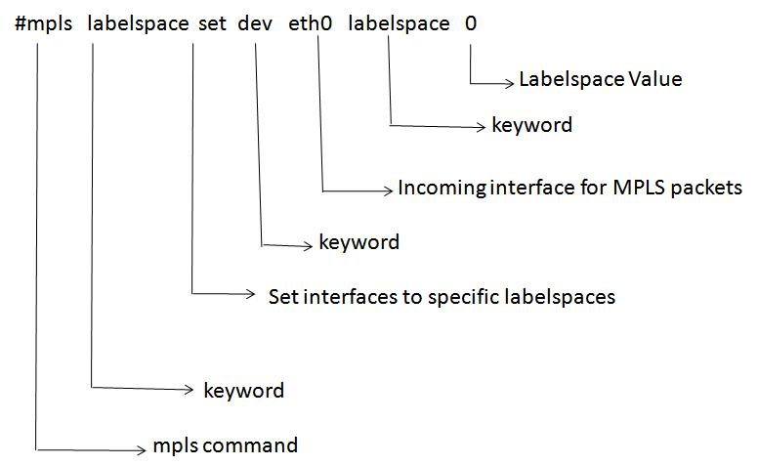
Commands(contd…)

Slide 7
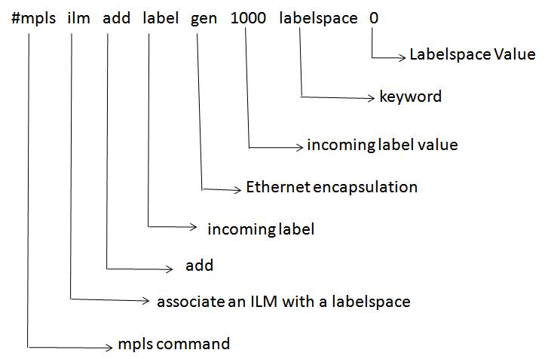
Commands(contd…)

Slide 8
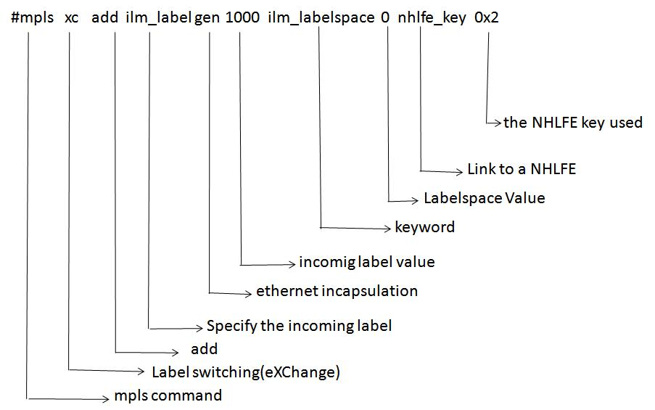
Commands(contd…)

Slide 9
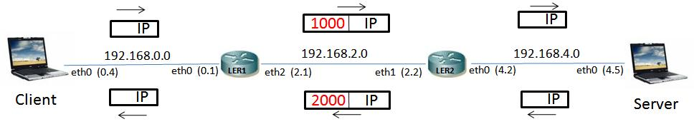
Experiment 1
Basic experiment with two LERs

Slide 10
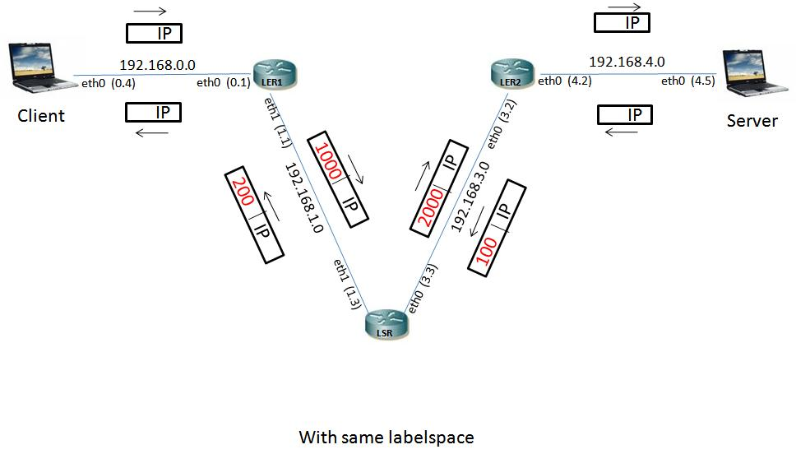
Experiment 2
With same labelspace

Slide 11
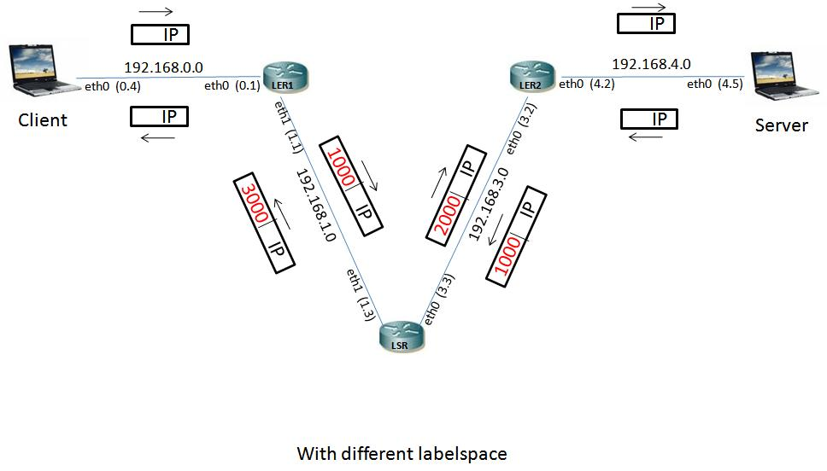
Experiment 3
With different labelspace

Slide 12
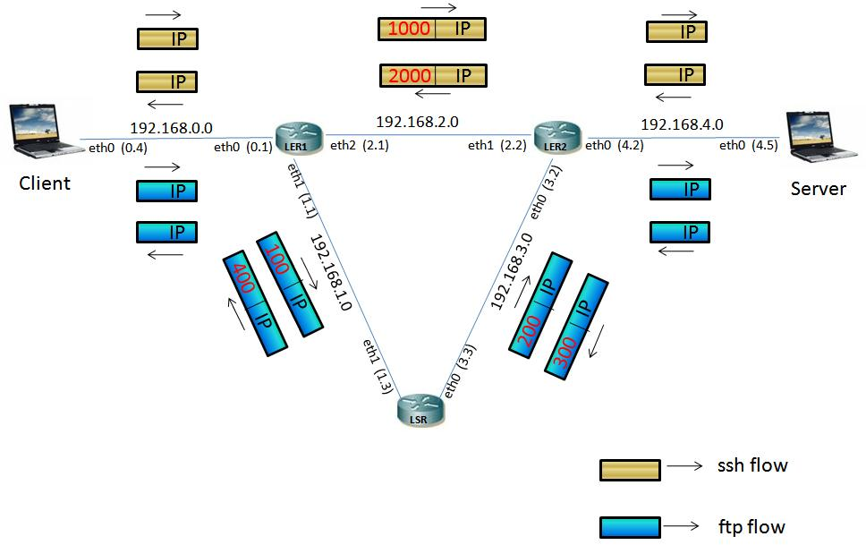
Experiment 4
Different LSPs for different flows

Slide 13
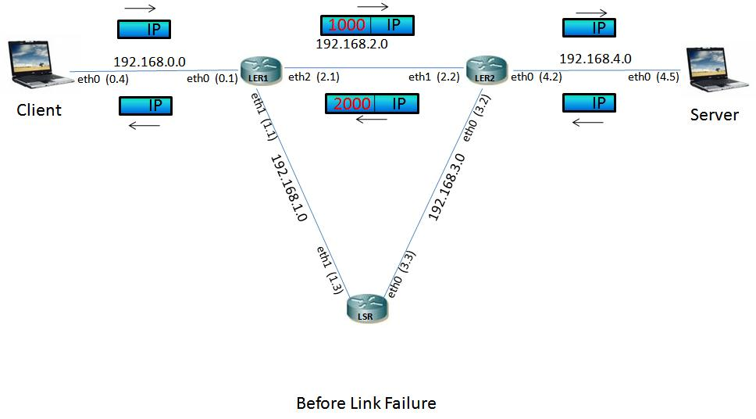
Experiment 5
Protection from link failure

Slide 14
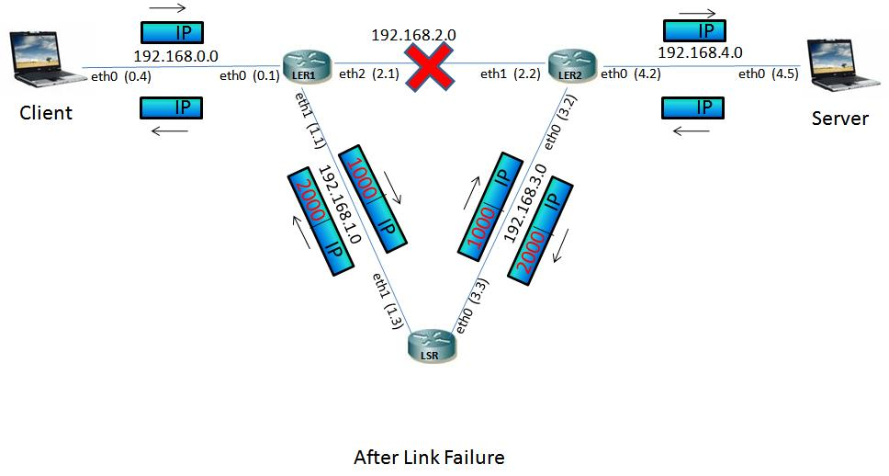
Experiment 5(contd…)
Protection from link failure

Slide 15
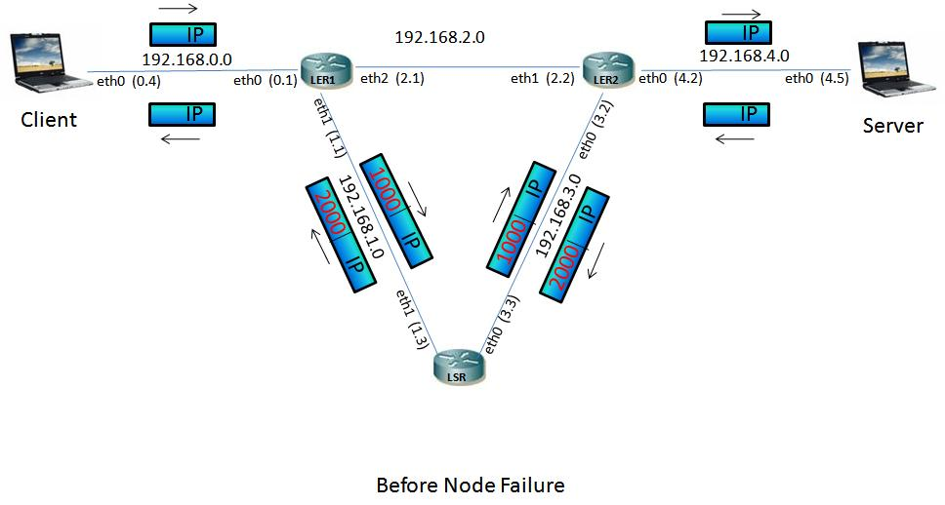
Experiment 6
Protection from node failure

Slide 16
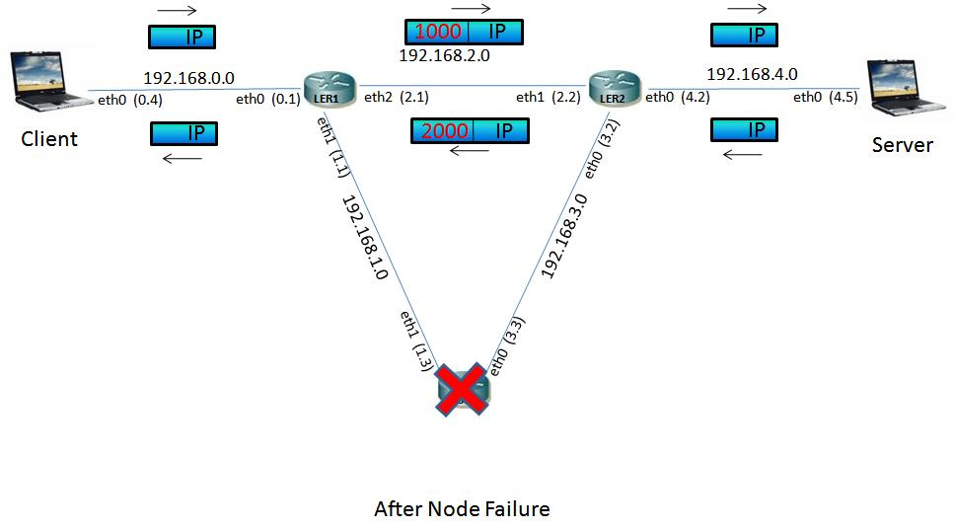
Experiment 6(contd…)
Protection from node failure

Slide 17
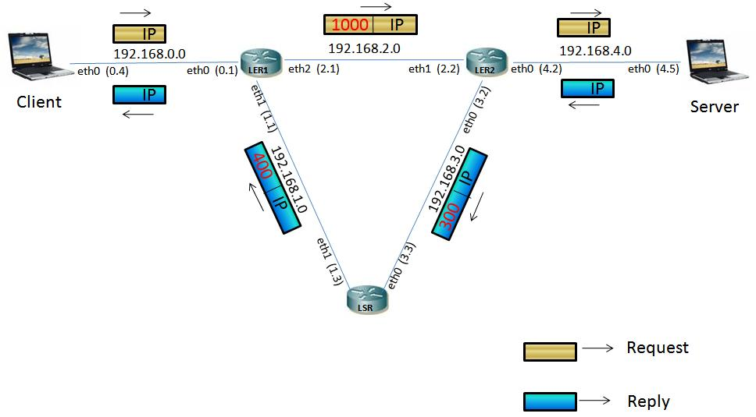
Experiment 7
Different LSPs for Request and Reply

Slide 18
References
http://rpmfind.net/linux/rpm2html/ for various rpms
http://sourceforge.net/projects/mpls-linux/ for mpls documentation and command reference
Internet QoS: Architectures and Mechanisms for Quality of Service by Zheng Wang
https://help.ubuntu.com/community/PureFTP for the conguration of pureftp
http://mpls-linux.sourceforge.net/ for installation

